Slide 1
Cognitive choices with MonteCarlo Tree Search
Guy Barash

Slide 2
What is a problem (PDDL)
State:
 | var1 | var2 | var3
Is_person | Guy
Is_tile | Tile_1
Is_tile | Tile_2
Is_tile | Tile_3
Is_tile | Tile_Final
at | Guy | Tile_1
North | Tile_1 | Tile_2
South | Tile_2 | Tile_1
North | Tile_2 | Tile_3
South | Tile_3 | Tile_2
North | Tile_3 | Tile_Final
South | Tile_Final | Tile_3

Slide 3
What is a problem (PDDL)
Action: (move_North Guy Tile_1 Tile_2)
 | var1 | var2 | var3
Is_person | Guy
Is_tile | Tile_1
Is_tile | Tile_2
Is_tile | Tile_3
Is_tile | Tile_Final
at | Guy | Tile_1
North | Tile_1 | Tile_2
South | Tile_2 | Tile_1
North | Tile_2 | Tile_3
South | Tile_3 | Tile_2
North | Tile_3 | Tile_Final
South | Tile_Final | Tile_3
Check:
(Is_person Guy)
(Is_tile Tile_1)
(Is_tile Tile_2)
(North Tile_1 Tile_2)
(at Guy Tile_1)
Remove:
(at Guy Tile_1)
Add:
(at Guy Tile_2)

Slide 4
What is a problem (PDDL)
Action: (move_North Guy Tile_1 Tile_2)
 | var1 | var2 | var3
Is_person | Guy
Is_tile | Tile_1
Is_tile | Tile_2
Is_tile | Tile_3
Is_tile | Tile_Final
at | Guy | Tile_1
North | Tile_1 | Tile_2
South | Tile_2 | Tile_1
North | Tile_2 | Tile_3
South | Tile_3 | Tile_2
North | Tile_3 | Tile_Final
South | Tile_Final | Tile_3
 | var1 | var2 | var3
Is_person | Guy
Is_tile | Tile_1
Is_tile | Tile_2
Is_tile | Tile_3
Is_tile | Tile_Final
at | Guy | Tile_2
North | Tile_1 | Tile_2
South | Tile_2 | Tile_1
North | Tile_2 | Tile_3
South | Tile_3 | Tile_2
North | Tile_3 | Tile_Final
South | Tile_Final | Tile_3

Slide 5
What is a Solution (PDDL)
Goal: (at Guy Tile_Final)
 | var1 | var2 | var3
Is_person | Guy
Is_tile | Tile_1
Is_tile | Tile_2
Is_tile | Tile_3
Is_tile | Tile_Final
at | Guy | Tile_2
North | Tile_1 | Tile_2
South | Tile_2 | Tile_1
North | Tile_2 | Tile_3
South | Tile_3 | Tile_2
North | Tile_3 | Tile_Final
South | Tile_Final | Tile_3

Slide 6
Problem description
One agent, multiple problems.
Solve solitaire, satellite navigation, chess, maze-cheese search,
Solve “GO”, solve robot-in-mars , ……….
Deterministic & non deterministic
90% “move north” goes north, sometimes goes south
Short & long term problems
Some worlds a HUGE and requires complex behavior.

Slide 7
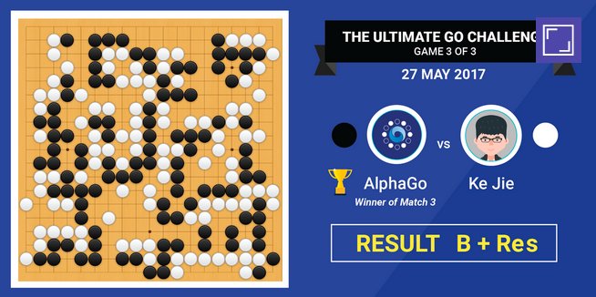
Solution
Monte Carlo tree search! [1]
World champion at “GO”.
Great in big worlds.
Requires little training
Can respond well to new situations
[1] Silver, David, et al. "Mastering the game of Go with deep neural networks and tree search." nature 529.7587 (2016): 484.

Slide 8
States to Nodes
Legal actions:
(move_north Guy Tile_2 Tile_3)
(move_south Guy Tile_2 Tile_1)
 | var1 | var2 | var3
Is_person | Guy
Is_tile | Tile_1
Is_tile | Tile_2
Is_tile | Tile_3
Is_tile | Tile_Final
at | Guy | Tile_2
North | Tile_1 | Tile_2
South | Tile_2 | Tile_1
North | Tile_2 | Tile_3
South | Tile_3 | Tile_2
North | Tile_3 | Tile_Final
South | Tile_Final | Tile_3

Slide 9
States to Nodes
STATE HASH: 234823904
STATE: [at p1 t3]
Total state_visits: 9
Total rewards: 60
[move_north Guy Tile_2 Tile_3]
Action_visits: 6
Rewards: 60
[move south Guy Tile_2 Tile_1]
Action_visits: 3
Rewards: 0

Slide 10

Policy
Dictionary – because some world are HUGE
HASH | pointer
3445436 | *pointer to state*
61546561 | *pointer to state*
-6545625 | *pointer to state*
35646546 | *pointer to state*
-435235435 | *pointer to state*
234543543 | *pointer to state*
7568768 | *pointer to state*

Slide 11
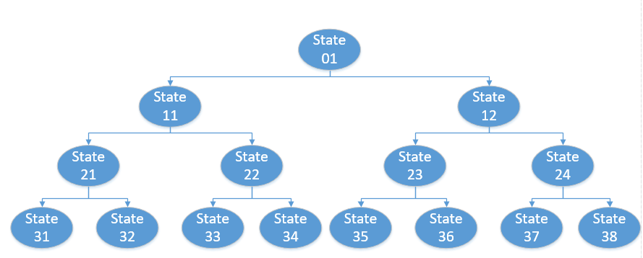
Traveling the world
All possible states are a graph connected by actions
Will be big.
Can have loops.

Slide 12
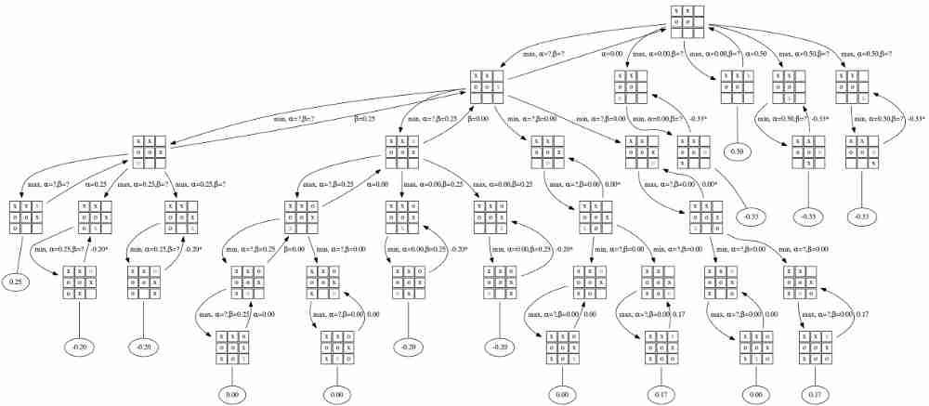
Traveling the world
All possible states are a graph connected by actions

Slide 13
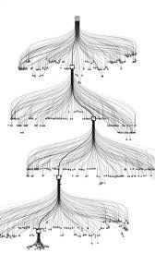
Solution
Can’t simulate ALL of the paths. Too many.
Visit only some.

Slide 14
Traveling the world
All possible states are a graph connected by actions

Slide 15
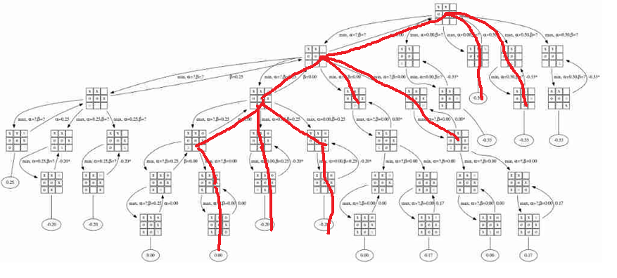
Traveling the world
All possible states are a graph connected by actions

Slide 16
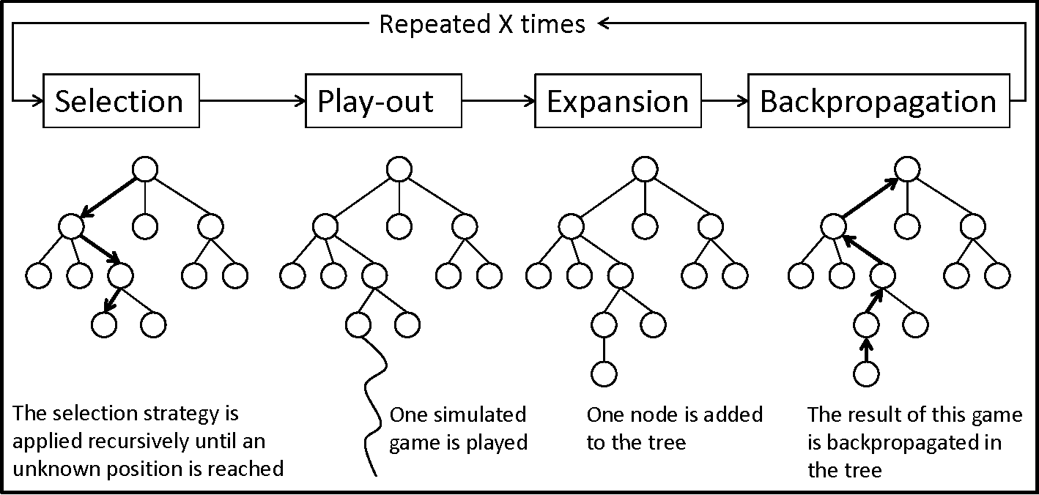
Work stages
Visits only a segment of the entire space

Slide 17
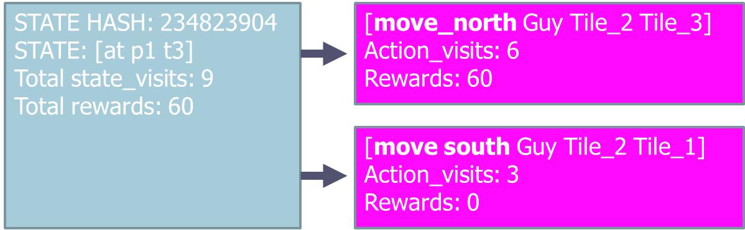
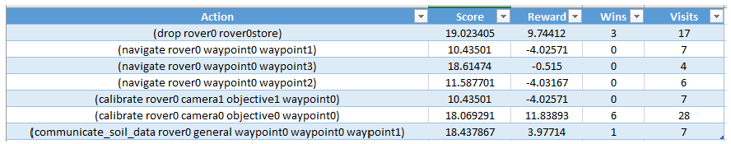
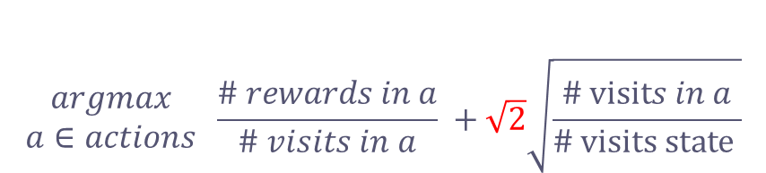
Work stages
$$\begin{matrix}argmax \\ a∈actions\end{matrix} \frac{\# rewards in a}{\# visits in a} +\sqrt{2}\sqrt{\frac{\# visits in a}{\# visits state }}$$
Explore!
[2]Kocsis, Levente, and Csaba Szepesvári. "Bandit based monte-carlo planning." European conference on machine learning. Springer, Berlin, Heidelberg, 2006.
[3] Auer, P., Cesa-Bianchi, N. & Fischer, P. Finite-time Analysis of the Multiarmed Bandit Problem. Machine Learning 47, 235–256 (2002). https://doi.org/10.1023/A:1013689704352

Slide 18
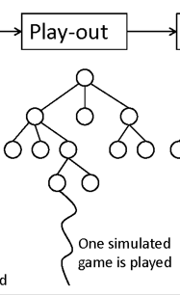
Work stages
Apply action to current state. Get a new state. Randomly choose actions and apply until:
STOP REASON | Reward
DEAD END | -2
Solving a single predicate | +10
Solving the game | +60
LOOP | -4
Depth limit | 0.0

Slide 19
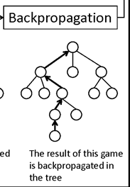
Work stages
Start in the last node.
Visit += 1
Rewards += {reward}
Go one node up
Repeat until root.

Slide 20
Work stages
Start in the last node.
Visit += 1
Rewards += {reward}
Go one node up
Repeat until root.

Slide 21
Rewards
condition | Reward | Terminal
Win | +60 | ✓
Solve a new predicate | +10
Dead end | -2 | ✓
Depth limit | 0 | ✓
Step penalty | -0.01
Visiting same state 4+ times in simulation | -4 | ✓
Step a state visited by real agent | -2

Slide 22
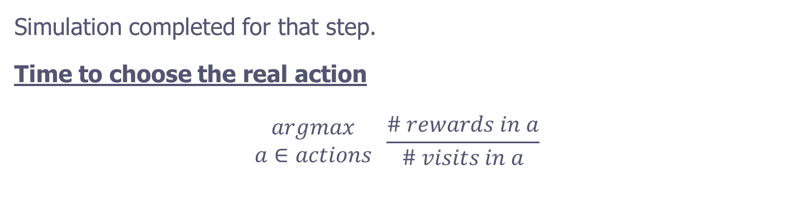
recommend stage
Simulation completed for that step.
Time to choose the real action
$$\begin{matrix}argmax \\ a∈actions\end{matrix} \frac{\# rewards in a}{\# visits in a}$$
Exploit!

Slide 23
Repeat

Slide 24
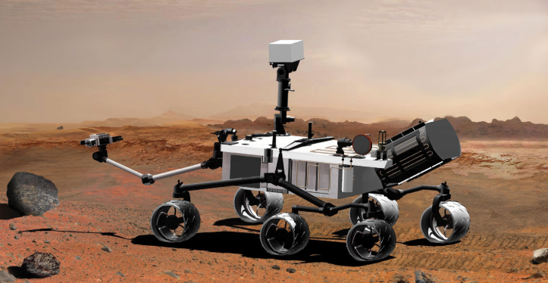
Example
A Rover on mars
Navigate rover position_X position Y
Sample_rocks at position
Sample_soil at position
Calibrate camera (3 different cameras!)
Take photo
Send_image_to_earth {select quality}
Drop sample
Goal:
Send image of soil from position 7 to earth on low resolution from camera 2
Send image of rocks from position 3 to earth on HIGH resolution from camera 1

Slide 25
Example
Step 1:
(navigate rover0 waypoint0 waypoint1)
[# 1] Score: +21.569717 Rewards: +12.99889 Wins: 3/18.0 (0.167) loops: 9/18.0 (0.500) depth-cap: 6/18.0 (0.333)
(navigate rover0 waypoint0 waypoint3)
[# 2] Score: +21.171777 Rewards: +6.32667 Wins: 0/6.0 (0.000) loops: 3/6.0 (0.500) depth-cap: 3/6.0 (0.500)
(navigate rover0 waypoint0 waypoint2)
[# 3] Score: +16.994156 Rewards: -4.00000 Wins: 0/3.0 (0.000) loops: 3/3.0 (1.000) depth-cap: 0/3.0 (0.000)
(sample_rock rover0 rover0store waypoint0)
[# 4] Score: +20.176473 Rewards: +1.99500 Wins: 0/4.0 (0.000) loops: 3/4.0 (0.750) depth-cap: 1/4.0 (0.250)
(calibrate rover0 camera1 objective1 waypoint0)
[# 5] Score: +21.096973 Rewards: +9.59800 Wins: 1/10.0 (0.100) loops: 6/10.0 (0.600) depth-cap: 3/10.0 (0.300)
(sample_soil rover0 rover0store waypoint0)
[# 6] Score: +16.967489 Rewards: -4.02667 Wins: 0/3.0 (0.000) loops: 3/3.0 (1.000) depth-cap: 0/3.0 (0.000)
(calibrate rover0 camera0 objective0 waypoint0)
[# 7] Score: +14.831777 Rewards: -0.01333 Wins: 0/6.0 (0.000) loops: 5/6.0 (0.833) depth-cap: 1/6.0 (0.167)

Slide 26
Example
Step 10:
(take_image rover0 waypoint0 objective0 camera0 low_res) [Better for exploring]
[# 1] Score: +47.207022 Rewards: +27.85750 Wins: 2/4.0 (0.500) loops: 2/4.0 (0.500) depth-cap: 0/4.0 (0.000)
(take_image rover0 waypoint0 objective1 camera0 colour) [Better for real life]
[# 2] Score: +40.100713 Rewards: +27.86300 Wins: 5/10.0 (0.500) loops: 5/10.0 (0.500) depth-cap: 0/10
(take_image rover0 waypoint0 objective1 camera0 high_res)
[# 3] Score: +34.519045 Rewards: -4.18000 Wins: 0/1.0 (0.000) loops: 1/1.0 (1.000) depth-cap: 0/1.0
(drop rover0 rover0store)
[# 4] Score: +46.496713 Rewards: +34.25900 Wins: 6/10.0 (0.600) loops: 4/10.0 (0.400) depth-cap: 0/10.
(take_image rover0 waypoint0 objective0 camera0 high_res)
[# 5] Score: +39.552904 Rewards: +17.21000 Wins: 1/3.0 (0.333) loops: 2/3.0 (0.667) depth-cap: 0/3.0
…..
…..
[26 possible moves]

Slide 27
Example
Final step:
[# 1] Score: +64.407740 Rewards: +51.79100 Wins: 9/10.0 (0.900) loops: 1/10.0 (0.100) depth-cap: 0/10.0 (0.000)
(drop rover0 rover0store)
[# 2] Score: +76.088141 Rewards: +59.80000 Wins: 6/6.0 (1.000) loops: 0/6.0 (0.000) depth-cap: 0/6.0 (0.000)
(navigate rover0 waypoint0 waypoint1)
[# 3] Score: +73.102545 Rewards: +59.80333 Wins: 9/9.0 (1.000) loops: 0/9.0 (0.000) depth-cap: 0/9.0 (0.000)
(communicate_rock_data rover0 general waypoint0 waypoint0 waypoint1) [A winning move, but the machine doesn’t know]
[# 4] Score: +76.366698 Rewards: +69.80757 Wins: 37/37.0 (1.000) loops: 0/37.0 (0.000) depth-cap: 0/37.0 (0.000)
…..
…..
[14 possible moves]

Slide 28
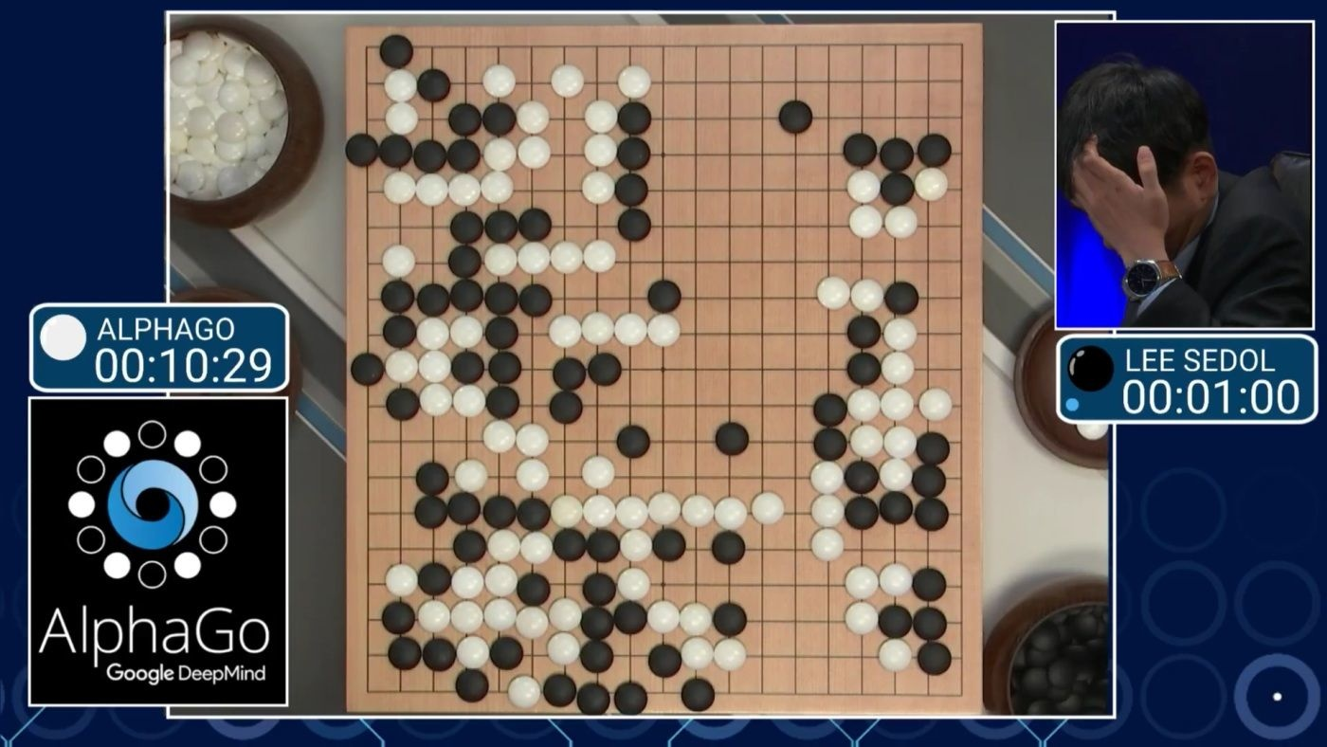
Questions?

